Slide 1
Capitalism
USA, Western Europe, Japan
Adam Smith, On the Wealth of Nations
John Locke, Two Treatises on Government
Samuel Smiles, Self-Help, Thrift
Six Features:
Markets
Competition
Voluntary Exchange
Economic Freedom
Private property
Profit Motive

Slide 2
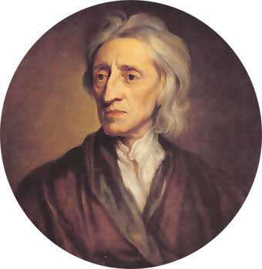
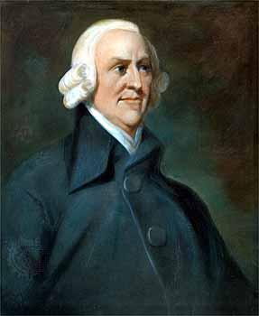

Slide 3
Capitalism
Advantages:
Most productive & most efficient economic system
Mass production of goods & services
Disadvantages:
Unequal distribution of wealth
Unfair system: children of previous winners have advantage
High crime rates
Morally void: CRA$$ commercialism

Slide 4
Fascism
Nazi Germany, Fascist Italy, Franco’s Spain
Benito Mussolini, The Doctrine of Fascism; Friedrich Nietzsche
The last stand of Capitalism
Private property retained
Statism: gov’t control of the economy with lucrative contracts
Large industrialists are benefited
Single party state

Slide 5
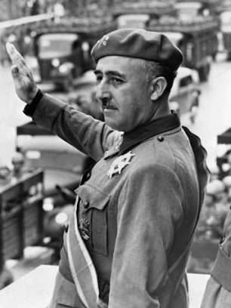
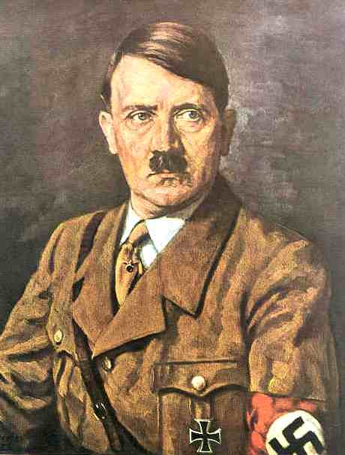
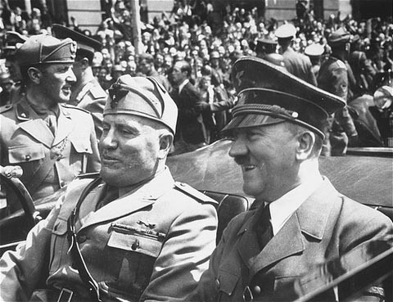

Slide 6
Fascism
Advantages:
Highly productive system
(Nazi Germany was booming in ’30’s when the world was in depression)
Many worker holidays
Nationalism reduces class antagonisms
Disadvantages:
No dissent allowed
The state is more important than the individual
You must buy into the party program
No labor unions or collective bargaining
Xenophobic

Slide 7
Socialism
Sweden, Denmark, Norway, Switzerland
Robert Owen in England, first to use term “socialist”; Saint Simon in France
Collective ownership
Gov’t owns major industries (energy, transportation, utilities, steel, communications)
High, progressive taxation

Slide 8
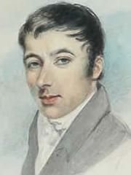
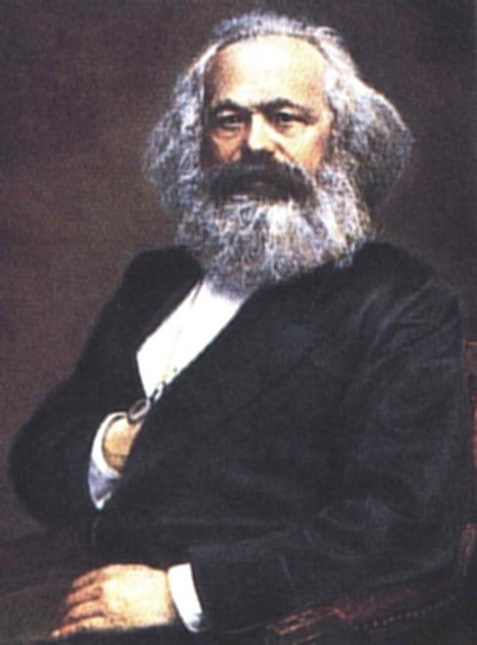

Slide 9
Socialism
Advantages:
More equal distribution of wealth
Universal higher education
Universal health care
Minimum standard of living guaranteed
Worker protection
Many paid holidays / vacations
Disadvantages:
High taxation – takes incentives away from working long & hard
Waiting lines in health care
Reduced quality

Slide 10
Communism
Former USSR, Cuba, China
Karl Marx & Friedrich Engel, The Communist Manifesto; Karl Marx, Das Kapital
Capitalism has inner contradictions
Violent revolution by the workers (proletariot)
Classless society: workers are owners & owners are workers
“Each will produce according to ability and each will receive according to need”

Slide 11
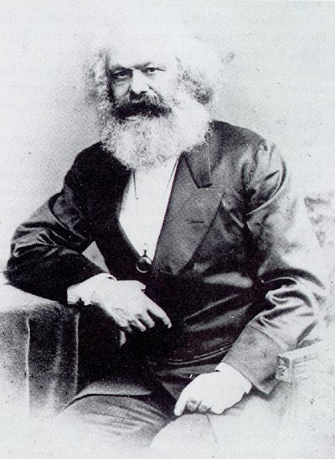
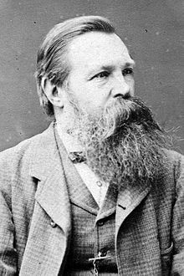

Slide 12
Communism
Advantages:
Universal peace
Universal prosperity
Everyone is a brother
No government
No greed, no coveting; everyone gets along
Disadvantages:
Marxist theory has never worked in reality
Marx’s view of history hasn’t gone the way he predicted
Capitalism has reformed itself

